Slide 1

ARTIK 05x
Confidential

Slide 2
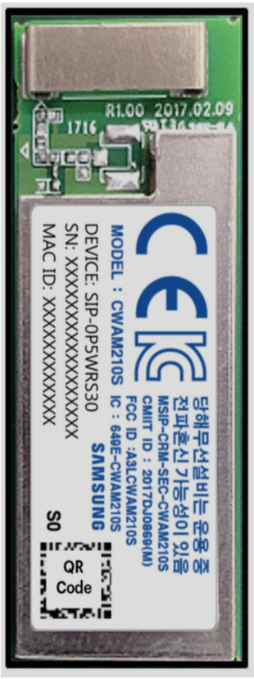

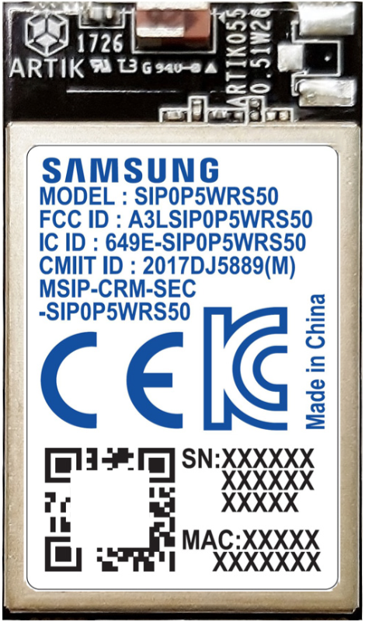
Samsung ARTIK™ 053/053s, 055s Wi-Fi® edge nodes Create secure, next-gen edge products
Processor | Main: ARM Cortex® R4 @ 320 MHz WLAN: ARM Cortex® R4 @ 480 MHz Security: ARM Cortex M0
Memory | RAM: 1.4 MB Flash: 8 MB SPI Flash on module
Connectivity | WLAN (Wi-Fi): IEEE 802.11 b/g/n
Regulatory | FCC (US), IC(Canada), CE(EU), KC(Korea), SRRC(China)
I/O | 2xSPI, 5xUART (2-pin), 4xI2C, 7xPWM, 28xGPIO, 1xJTAG, 4xADC
Operating voltage | 053, 053s: 5-12 VDC; 055s: 3.3 VDC
Temperature | -20° to 85° (°C)
Size | 055s: 15 mm W x 26 mm H x 3.9 mm D 053, 053s: 15 mm W x 40 mm H x 3.9 mm D
Security | Secure Subsystem, Hardware-protected key storage with secure point-to-point authentication and data transfer, secure boot*, KMS* *S-versions only
Home health monitors, AEDs, fitness equipment, CPAP
Smoke detectors, thermostats, energy monitors, appliances
Sensors, lighting controllers, motors, valves
Access control, fire monitors, smart switches
Notes:
FCC (US), IC(Canada), CE(EU), KC(Korea), SRRC(China)

Slide 3
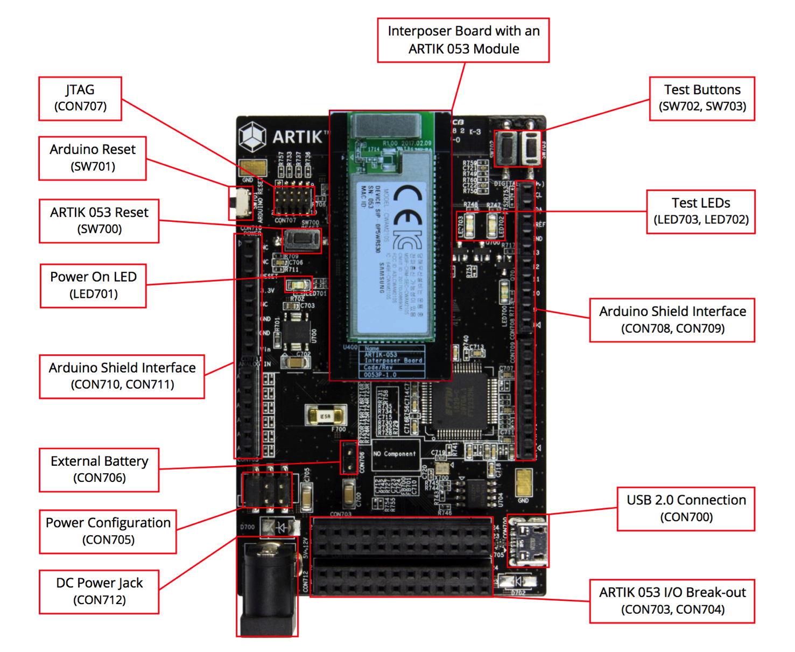
ARTIK 05x Starter Board
Notes:
Same platform board for 053 and 055.
For ARTIK053s module, the 5V-12V signal is input directly into the module. For ARTIK055s module, 5V-12V signal passes through a DC/DC converter on the 055s Interposer board, which reduces the input voltage to 3.3V.

Slide 4
Wi-Fi Subsystem
ARTIK05x supports 802.11b/g/n Wi-Fi at 2.4GHz
Dedicated Wi-Fi Processor subsystem with 480MHz 32-bit ARM Cortex R4 supported by 32KB I-Cache and 16KB D-Cache
WiFi throughput: ~25 Mbps single stream
WPA/WPA2
Notes:
WiFi Throughput varies depending on applications, distance, test environment etc.
WPA and WPA2 are two of the security measures that can be used to protect wireless networks.

Slide 5
Samsung ARTIK™ 05x WiFi – wpa_supplicant
Supplicant is used in the client stations for key negotiation with a WPA Authenticator.
wpa_supplicant is cross-platform supplicant with support for WEP, WPA and WPA2.
wpa_supplicant is designed to use hardware, driver and OS independent, portable C code for all WPA functionality.
A daemon program running in the background and acting as the backend component controls the wireless connection.

Slide 6
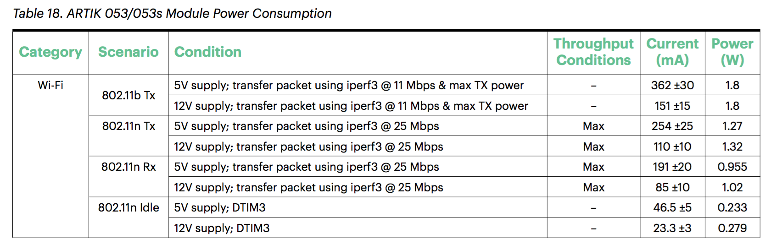
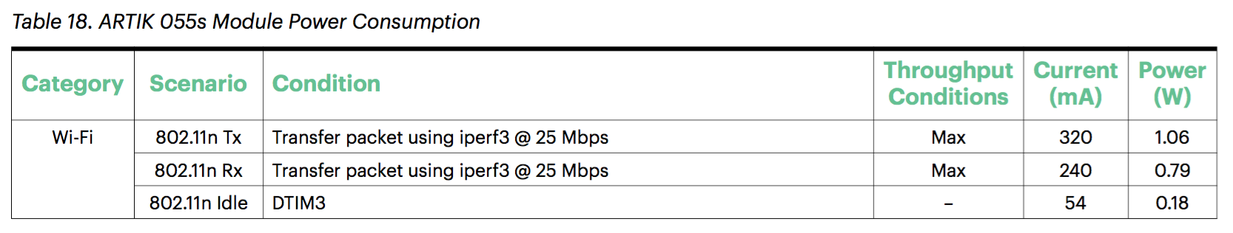
Samsung ARTIK™ 05x Power Management
(measured using 5-12V system power supply)
(measured using 3.3V system power supply)
Notes:
Reduce AP R4 320MHz->26Hz Idle (wait in Idle mode). Sj5_idle.c.
55mA normal cases
48mA WiFi (DTIM 1? DTIM 3?)
28mA ?

Slide 7
TizenRT OS Basics
ARTIK 05x are powered by TizenRT RTOS.
TizenRT is a lightweight RTOS-based platform to support low-end IoT devices, based on Nuttx
TizenRT is Nuttx kernel plus middle wares, it is highly configurable and suitable for small to moderate sized embedded system
Contains IP Network Stack
Notes:
ANSI C has to work just about everywhere. So it assumes only a simple view of its environment. Posix is designed for powerful operating system like Linux. As one example, look at signals. With posix you can send a signal to another process via the kill() system call. You specify which process gets the signal by supplying a pid. Ansi c only has a wimpy raise() which lets a process send a signal to itself. This is because Ansi C does not assume that it is even possible to run several processes at once. You won't find a pid in any Ansi C call. Posix demands multiple processes. Ansi C does not.

Slide 8
TizenRT OS Basics (Con’t)
Tizen RT strives to be standards compliant. It contains a small, scalable, bash-like shell, and it adopts Linux-style development components:
POSIX API
BSD Socket API
TASH Shell
Kconfig build configuration
Notes:
ANSI C has to work just about everywhere. So it assumes only a simple view of its environment. Posix is designed for powerful operating system like Linux. As one example, look at signals. With posix you can send a signal to another process via the kill() system call. You specify which process gets the signal by supplying a pid. Ansi c only has a wimpy raise() which lets a process send a signal to itself. This is because Ansi C does not assume that it is even possible to run several processes at once. You won't find a pid in any Ansi C call. Posix demands multiple processes. Ansi C does not.

Slide 9
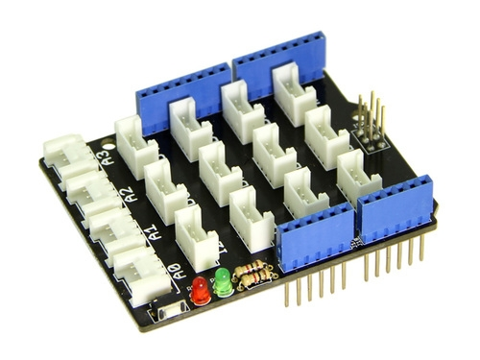
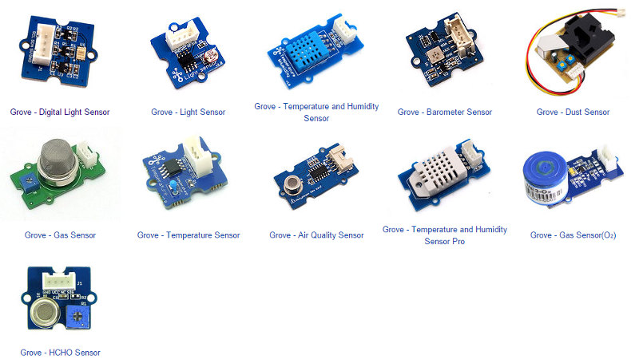
Grove Base Shield and Modules Support

Slide 10
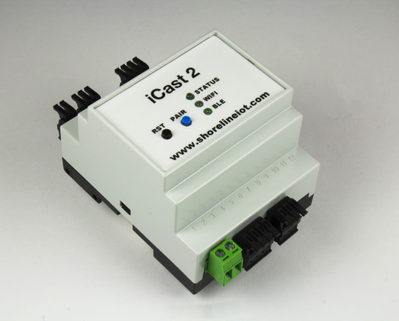
Shoreline iCast2 Modbus Solution ARTIK 05x
ARTIK 05x Module
Wi-Fi 2.4GHz, BLE 5.0 including 802.15.4 Radio and Thread SW stack
Analog I/O, GPIO, I2C etc.
Isolated RS485 serial port
Supports ARTIK Cloud, PTC ThingWorx, AWS IoT
Notes:
MODBUS is a protocol between a host (master) and devices (slaves) to access the configuration of the devices and to read the measures.
As there can be several devices connected in parallel on the RS485 bus, each slave device must use a unique MODBUS Slave ID on the bus.

Slide 11
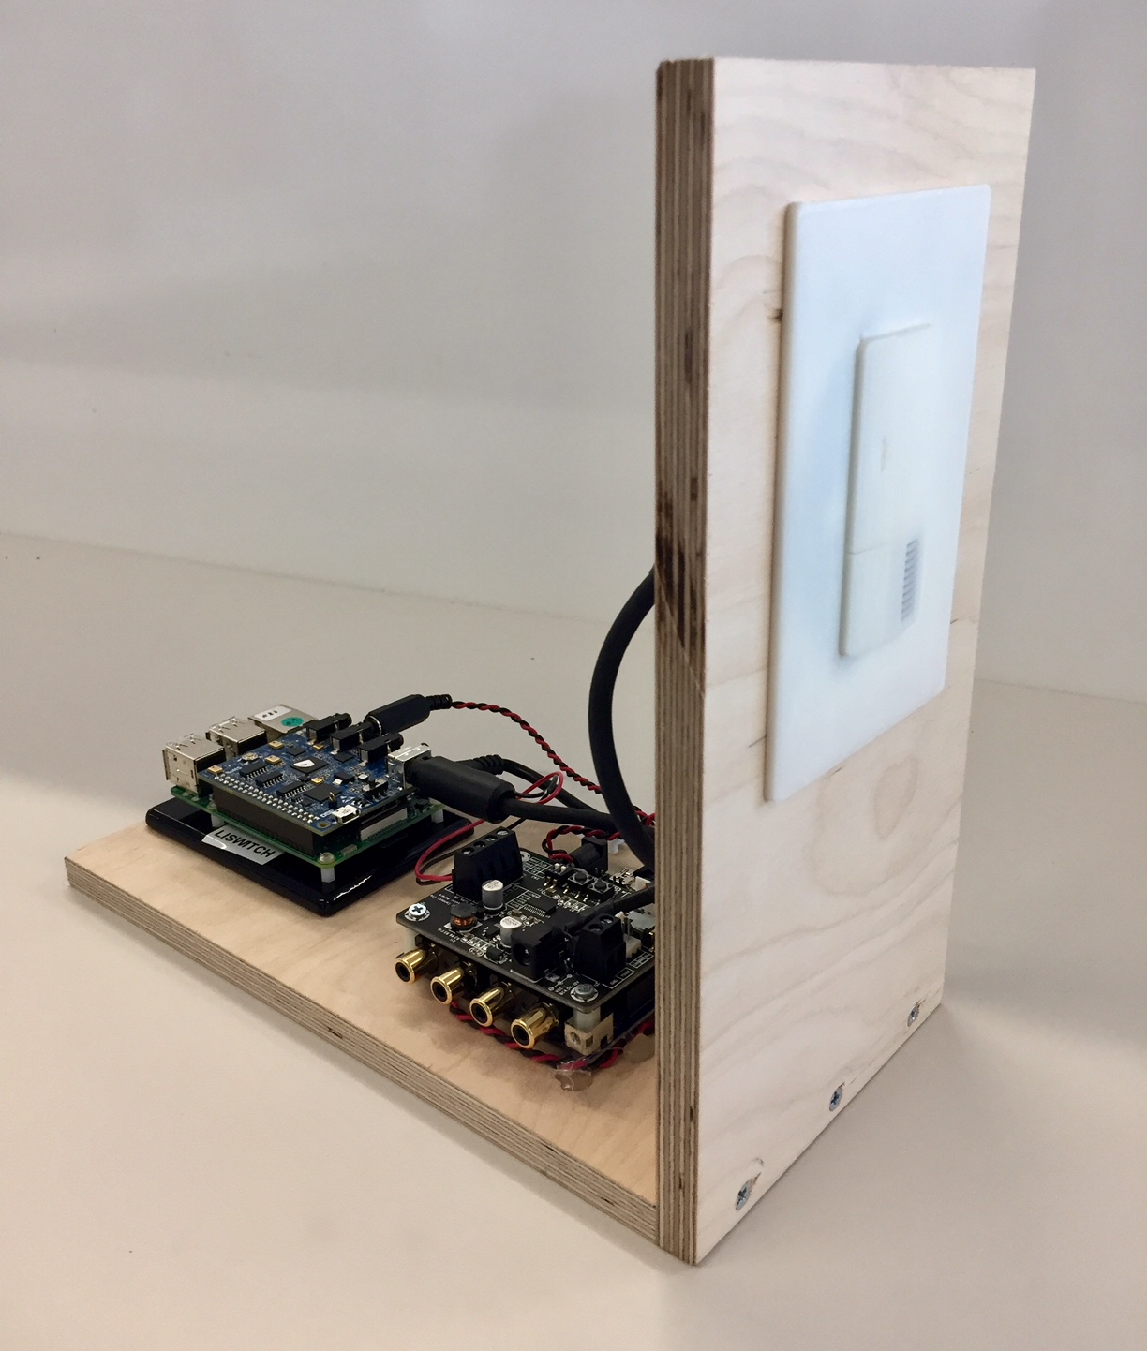
Voice-enabled switch ARTIK 05x, ARTIK 530 SoMs and AVS Gateway
Smart switch based on ARTIK 05x and ARTIK 530 for AVS connectivity. Voice detection done on Synaptics DSP.
Use case: Smart Home, Smart Building, Smart Hotel
Hardware: ARTIK05x, ARTIK 530, DSP
Software: Alexa Voice Service on 530, 05x sensor logic, control logic on 05x, ARTIK Cloud connectivity via 05x

Slide 12
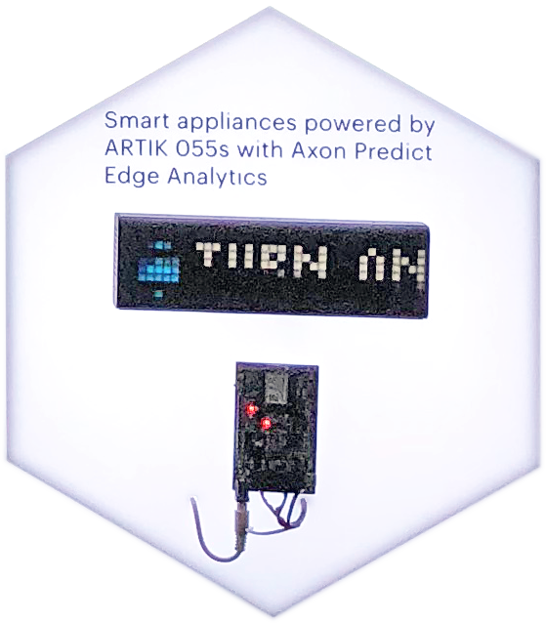
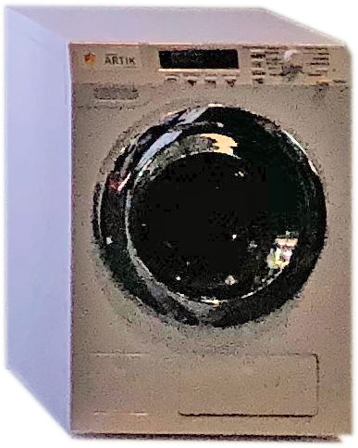
Smart appliances and edge analytics ARTIK 055s SoM and Axon Predict Edge Analytics
ARTIK 055s-powered smart washer with edge analytics for detergent level check, predictive maintenance, etc. Washer can be controlled by a mobile app or voice. Alerts show on LaMetrics display.
Use case: Smart home appliances
Hardware: ARTIK 055s WiFi module, washer with weight sensor, water level sensor etc., mobile device, LaMetrics display (optional)
Software: SmartThings Cloud cloud connector, rules engine; Android mobile app; AXON Predict Analytics

Slide 13
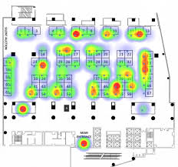
Location based service ARTIK 05x
Leverage 05x WiFi connectivity for location based service.
Use case: Smart Building, Smart Campus
Hardware: ARTIK05x
Software: Comtech Location APIs, ARTIK Cloud Service

Slide 14
Lab: MQTT
Confidential

Slide 15
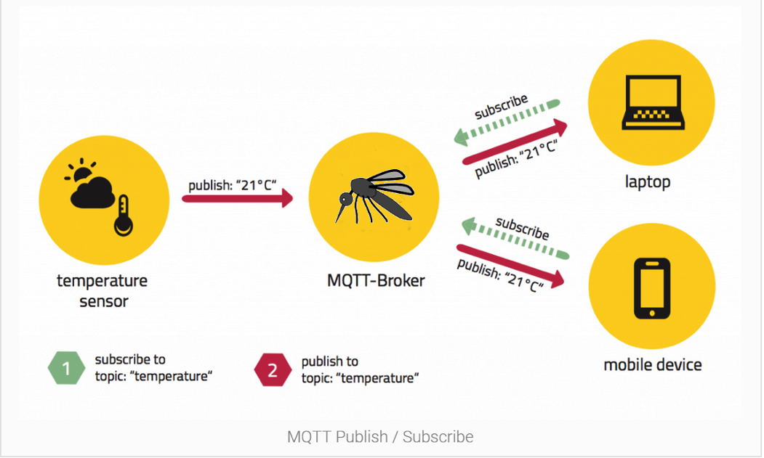
Message Queue Telemetry Transport (MQTT)
MQTT history
Light-weight messaging protocol, rides on TCP
Broker / Clients architecture
Publication / Subscription messaging model
No pre-defined format for payload
Notes:
MQTT was invented by Andy Stanford-Clark (IBM) and Arlen Nipper (Arcom, now Cirrus Link) back in 1999, when their use case was to create a protocol for minimal battery loss and minimal bandwidth connecting oil pipelines over satellite connection. They specified the following goals, which the future protocol should have:
Simple to implement
Provide a Quality of Service Data Delivery
Lightweight and Bandwidth Efficient
Data Agnostic
Continuous Session Awareness

Slide 16
Message Queue Telemetry Transport (MQTT)
The publish/subscribe message pattern to provide one-to-many message distribution and decoupling of applications
Publish/subscribe is event-driven and enables messages to be pushed to clients
The central communication point is the MQTT broker, it is in charge of dispatching all messages between the senders and the rightful receiver
Each client that publishes a message to the broker, includes a topic into the message. The topic is the routing information for the broker
Each client that wants to receive messages subscribes to a certain topic and the broker delivers all messages with the matching topic to the client
Therefore, the clients don’t have to know each other
This architecture enables highly scalable solutions without dependencies between the data producers and the data consumers
Notes:
This architecture decouples the publisher and subscriber. They do not have to know each other and do not need to run at the same time.
Can a client be a publisher and subscriber at the same time?

Slide 17
Message Queue Telemetry Transport (MQTT)
A Message Queue stores message until they are consumed. In MQTT, it is possible the message is not processed by any client.
In Message Queue, a message will only be consumed by one client
MQTT has more flexibility compared to a message queue

Slide 18

Message Queue Telemetry Transport (MQTT)
MQTT client includes publisher or subscriber
In general, a MQTT client can be both a publisher & subscriber at the same time
A MQTT client can run on any device from a micro controller up to a server. MQTT C client code only takes 30KB, Java code is about 100KB.
MQTT client libraries are available for a huge variety of programming languages, e.g, C/C++, Arduino, Java, JavaScript, Android, iOS, C#, .NET
https://github.com/mqtt/mqtt.github.io/wiki/libraries
MQTT client: Eclipse Paho
MQTT.fx(available for Win/MacOS/Linux) etc.

Slide 19





Message Queue Telemetry Transport (MQTT)
MQTT Broker is responsible for receiving all messages, filtering them, and sending the messages to all subscribed clients.
It holds the session of all persistent clients including subscriptions and missed messages
Authentication and authorization of clients.
Self Hosted MQTT brokers:
Eclipse Mosquitto HiveMQ(licensed)
Cloud based MQTT brokers:
AWS Microsoft Azure IBM Bluemix
Eclipse Mosquitto (test.mosquitto.org) HiveMQ ( broker.hivemq.com)

Slide 20
APPENDIX
Confidential

